Slide 1

UNIT 2
Theory of the Firm & Consumer's Behaviour
Part 2: Budget Constraints, Optimal Allocation, & Calculus.
Part 1 established that consumers want to reach the highest indifference curve possible. Part 2 introduces the real-world limitation that prevents this - limited income - and explores the mathematical tools used to find the perfect balance between desires and affordability.

Slide 2
The Budget Constraint
The budget constraint represents all the combinations of goods a consumer can afford given their current income and the market prices of those goods.
Real-World Example 💡
Suppose your entertainment budget (I) is $100:
Movie tickets (X) cost $20 each → you can afford up to 5 movies
Streaming rentals (Y) cost $5 each → you can afford up to 20 rentals
Any combination along that straight line is affordable
Any combination costing $101 or more is out of reach
Unlike the curved indifference lines representing subjective happiness, the budget line is a strict, straight boundary. The slope is determined strictly by the ratio of market prices (−PX / PY), dictating the exact rate at which the market forces you to trade one good for another.
The budget line is the hard ceiling of consumer choice.
The formula for the budget constraint is:
Where P = Price, X/Y = Quantities, and I = Income.

Slide 3

Shifts and Pivots in the Budget Line
The budget line changes dynamically based on external economic factors. Two distinct types of movement can occur:
Income Changes → Parallel Shift
If income increases, the entire budget line shifts outward in a parallel fashion. You can afford more of everything, but the relative prices - the slope - haven't changed. A decrease in income shifts the line inward, reducing all purchasing power equally.
Price Changes → Pivot
If the price of only one good changes, the line pivots. If Good X becomes cheaper, the line pivots outward on the X-axis, expanding your purchasing power specifically for that item while leaving the other axis intercept unchanged.

Slide 4
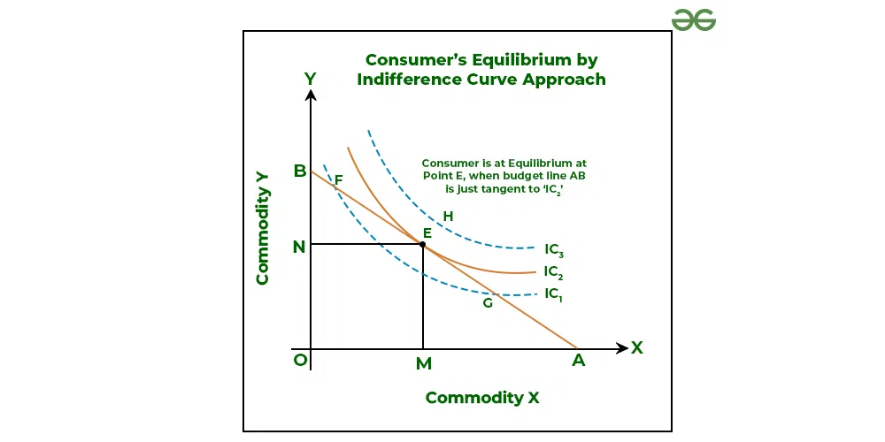
Optimal Allocation — Consumer Equilibrium
The Core Concept
The ultimate goal of the consumer is to reach the highest possible Indifference Curve without crossing their Budget Constraint line. The optimal choice is the exact point where the budget line is tangent to an indifference curve.
You want to be as happy as possible, but you are blocked by the boundary of your wallet. The most efficient, utility-maximizing point is the exact coordinate where your straight budget line just barely touches the highest reachable curve.

Slide 5
The Math of Optimal Allocation
At the exact point of optimal allocation, the slope of the indifference curve equals the slope of the budget line. This is expressed as:
What This Equation Means
Why It Matters
At equilibrium, your personal, subjective willingness to trade goods (MRS) is exactly equal to the objective market exchange rate (PX / PY). The two slopes : one from your preferences, one from the market - must be perfectly aligned.
If these two slopes did not match, the consumer could improve their happiness by reallocating their spending toward the good they value higher than the market does. The equilibrium condition ensures no further improvement is possible — the consumer is truly optimized.

Slide 6
Consumer Surplus
Consumer surplus is the economic measure of consumer benefit - the difference between the maximum price a consumer is willing to pay and the actual market price they end up paying.
The Core Idea
Real-World Example
This represents the psychological "win" of participating in a market. If you value an item heavily, but the market provides it cheaply, you capture that difference as surplus value. It proves that free trade can create wealth and satisfaction that isn't purely monetary.
You are walking through the city in a sudden downpour and decide you would gladly pay $25 for an umbrella to stay dry. You enter a convenience store and find umbrellas priced at $10. You purchase one and receive $15 in Consumer Surplus - the gap between your willingness to pay and the market price.

Slide 7
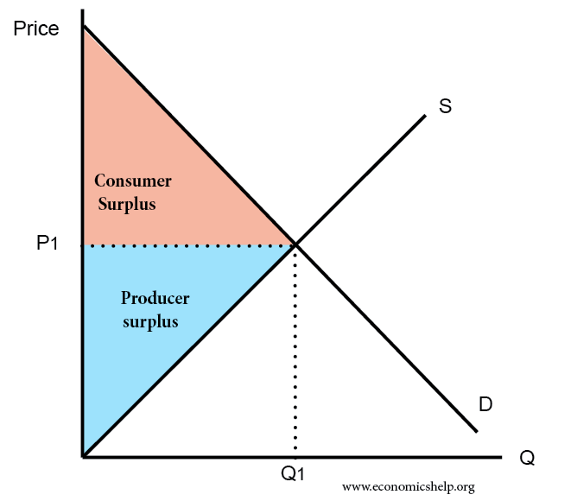
Visualizing Consumer Surplus
Reading the Graph
On a macroeconomic scale, consumer surplus is represented graphically as the area below the Demand Curve and above the horizontal Market Price line.
The downward-sloping Demand Curve plots the varying maximum willingness to pay of all consumers in a market. By drawing a horizontal line at the actual market price, we create a triangle.
The area of this shaded triangle calculates the total monetary benefit gained by all consumers who were willing to pay more than the going rate - a powerful measure of market welfare.
As the market price falls from P2 to P1, the triangle grows larger, meaning consumers collectively capture more surplus value from the transaction.

Slide 8

Applications of Calculus in Economics
Why Calculus?
Basic algebra is useful for discrete units (e.g., exactly 1 car, 2 cars), but modern economics deals with continuous variables and smooth curves. Calculus is required to find exact points of optimization on these curves.
Continuous Calculus
Smooth curve; exact instantaneous rate
If a firm's profit curve is a smooth arc, algebra can only calculate the average slope between two widely spaced points. Calculus provides the derivative - which acts like a laser pointer, identifying the exact rate of change at one microscopic, specific point on the curve.
Discrete Algebra
Step-like graph; average slope
This precision is what makes calculus indispensable for modern economic theory and optimization problems.

Slide 9


Calculus: The "Marginals"
In economic terminology, the word "Marginal" is virtually synonymous with the "First Derivative." Calculus provides the exact formulas for these critical economic concepts.
Marginal Product of Labor
Marginal Utility
Why It Matters
The additional satisfaction gained from consuming one more unit of a good is the derivative of the Utility function with respect to that good:
Without calculus, economists could only approximate these values. The derivative gives us exact, instantaneous rates of change - the foundation of all marginal analysis in microeconomics.
The exact output added by one infinitesimally small unit of labor is found by taking the partial derivative of the production function with respect to labor:

Slide 10
Calculus: Constrained Optimization
The Lagrangian Multiplier
Step-by-Step Logic
Advanced calculus is used to mathematically calculate the exact consumer equilibrium without relying on visual graphs. The technique is called the Lagrangian Multiplier.
01
Define the Utility Function
This method elegantly combines the Consumer's Utility function and their Budget Constraint equation into one master formula:
Express the consumer's happiness as a mathematical function U(X, Y).
02
Write the Budget Constraint
By taking the partial derivatives of this master formula and setting them to zero, we can mathematically solve for the exact, optimal quantities of goods a consumer should buy.
Set up the income limitation: PXX + PYY = I.
03
The Lagrangian approach transforms a visual, graphical problem into a precise algebraic solution - the pinnacle of consumer optimization theory.
Form the Lagrangian
Combine both into one master formula using the multiplier λ.
04
Solve the System
Take partial derivatives, set to zero, and solve for optimal X and Y.

Slide 11
